Slide 1


Slide 2


Slide 3


Slide 4


Slide 5
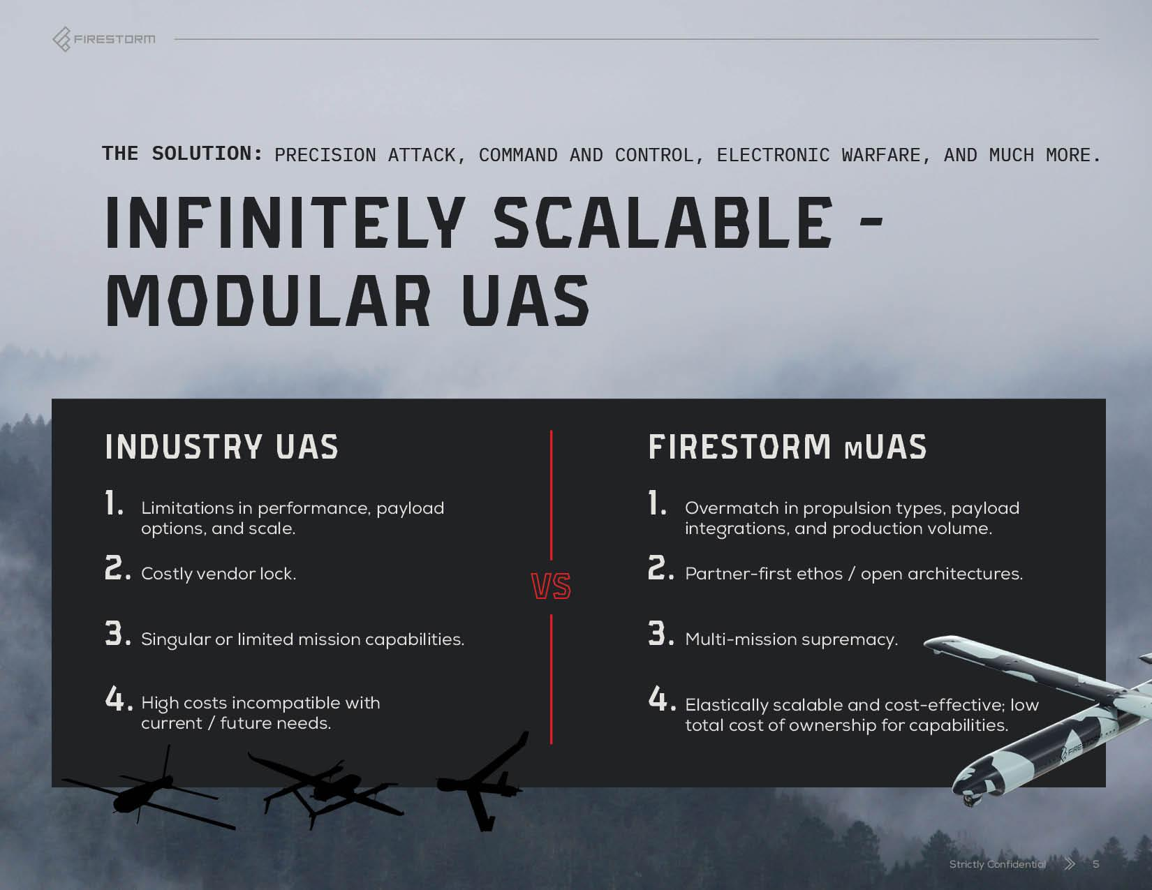

Slide 6
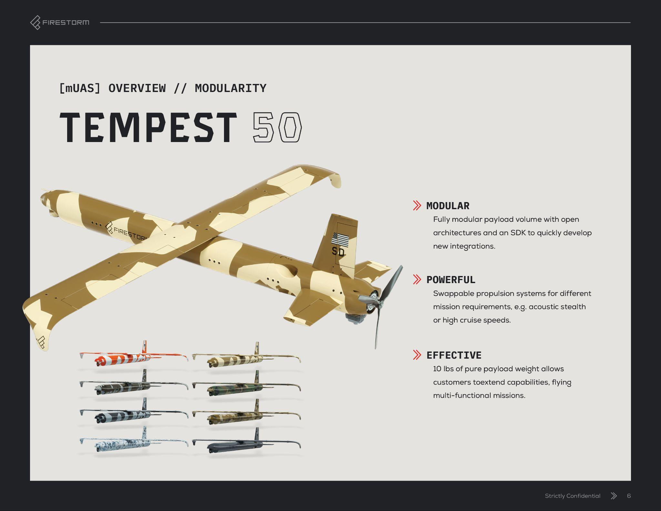

Slide 7
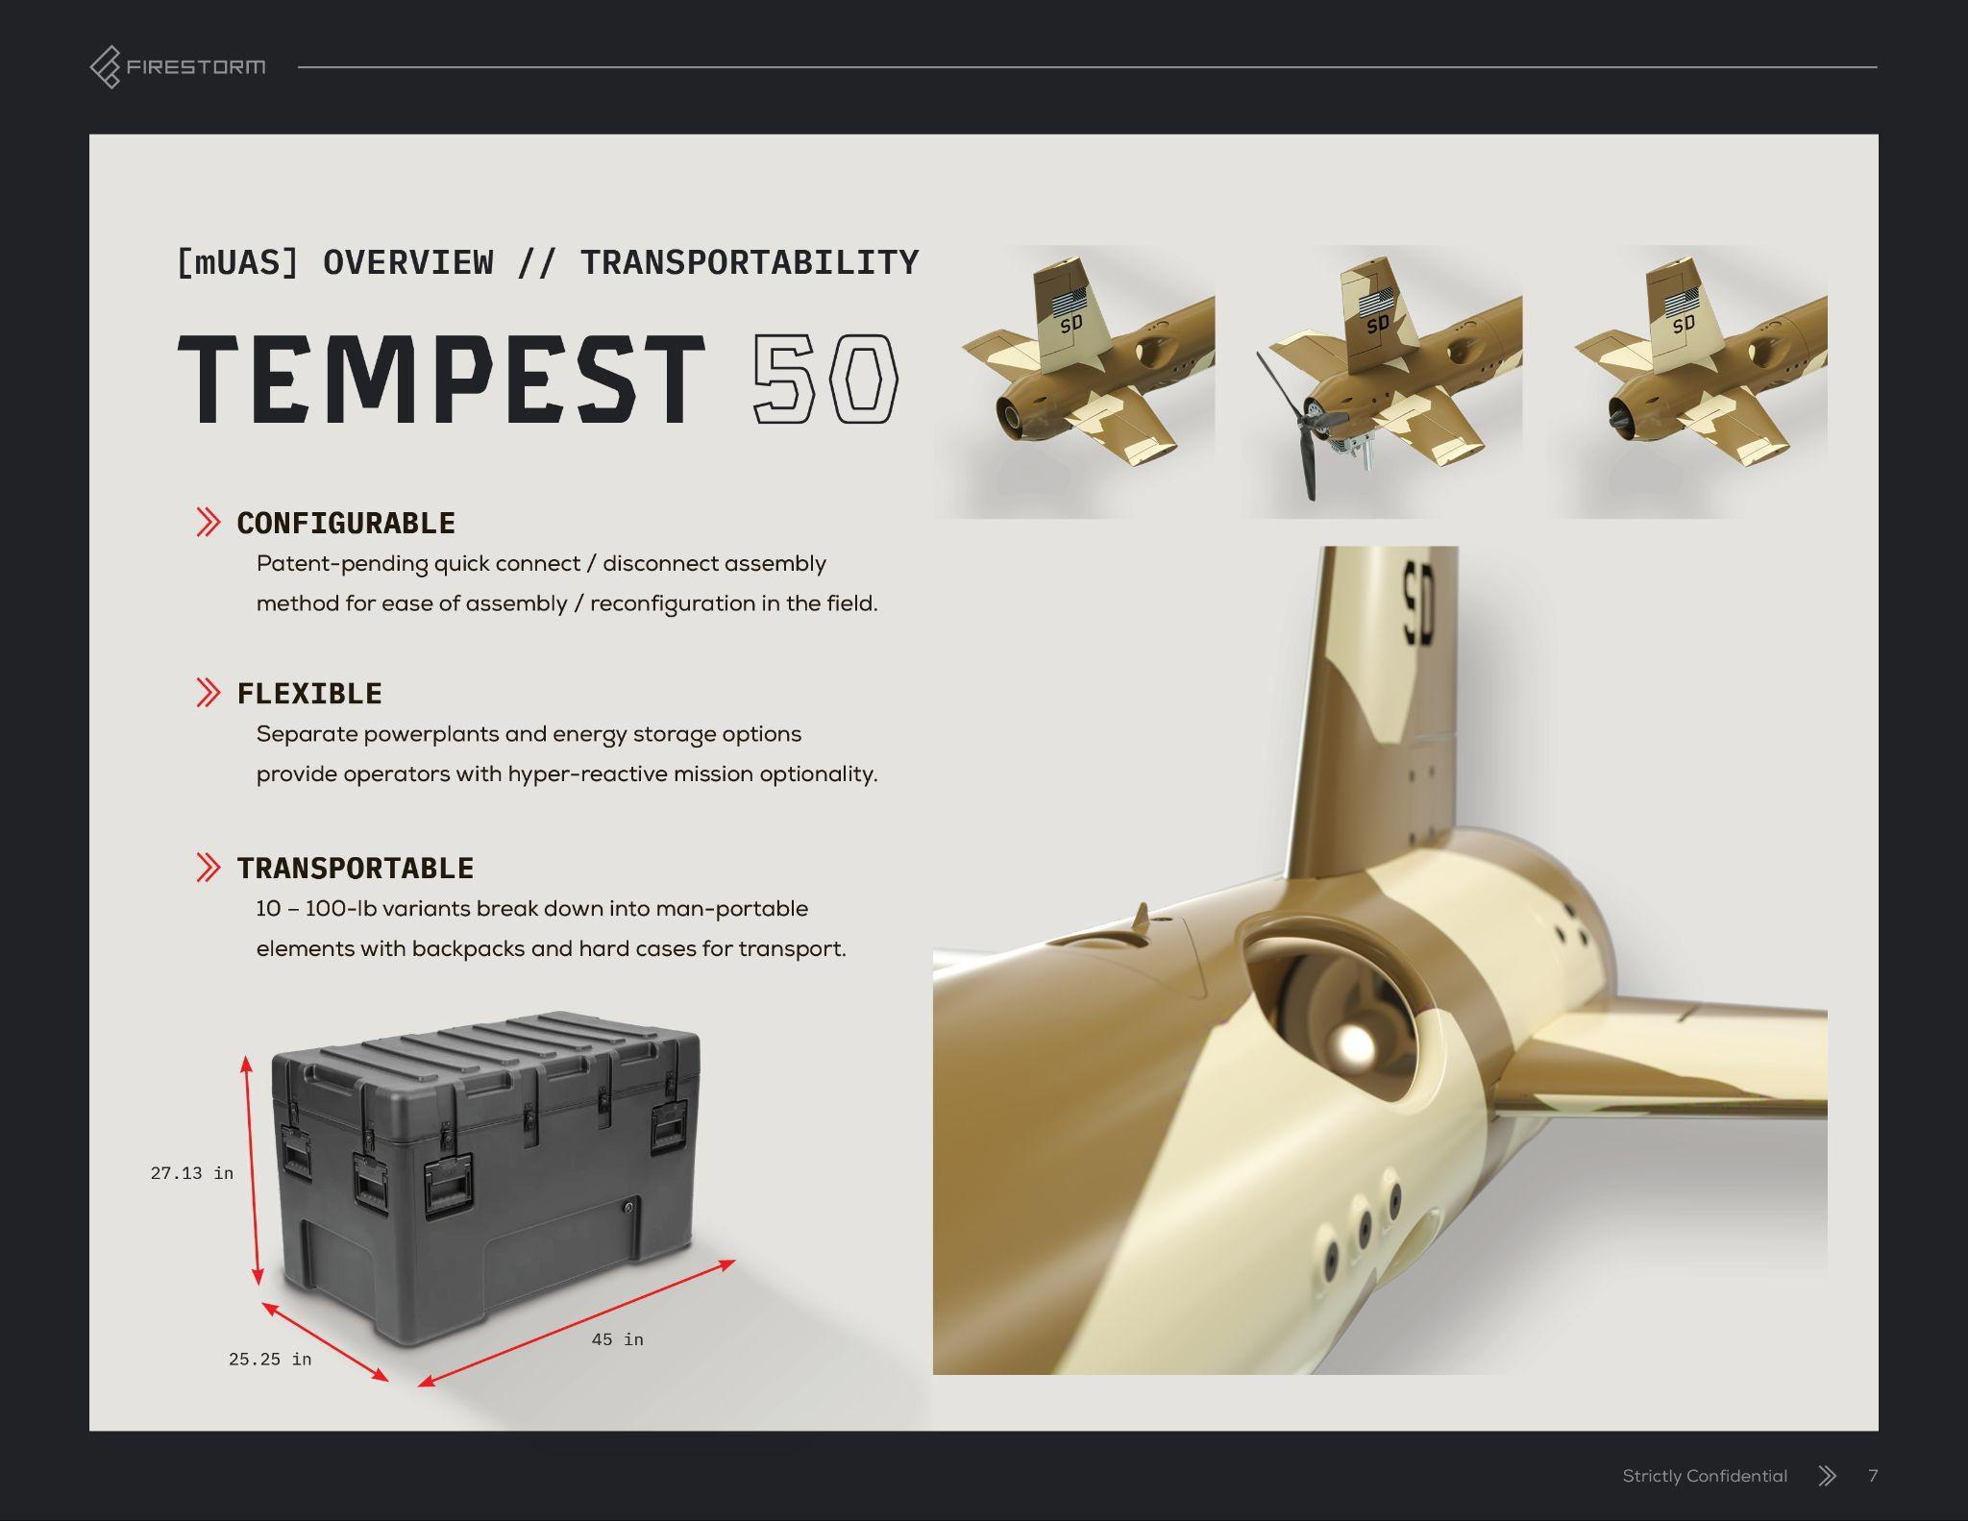

Slide 8
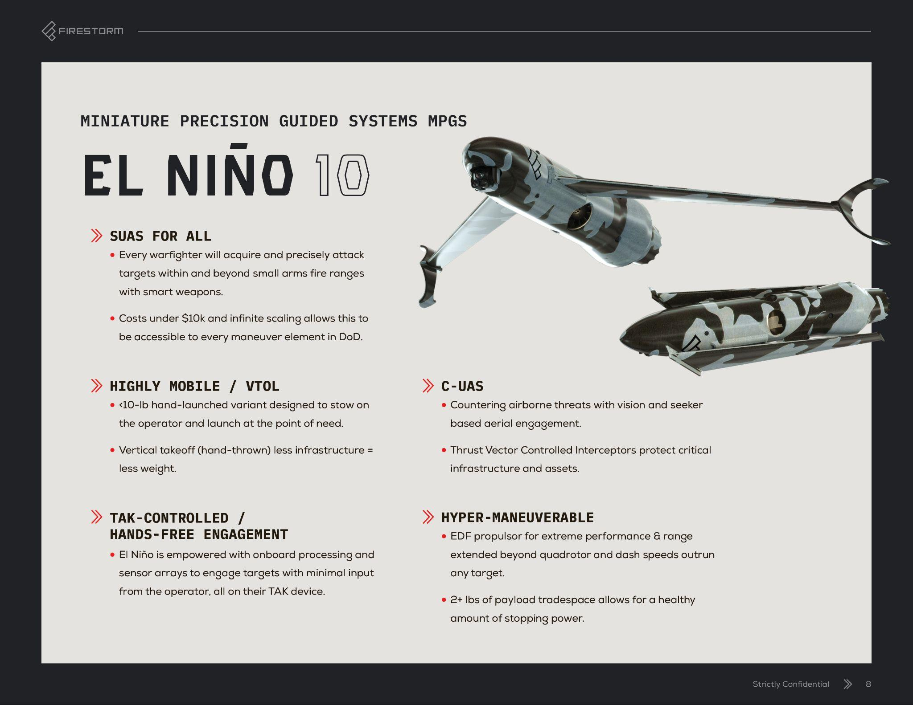
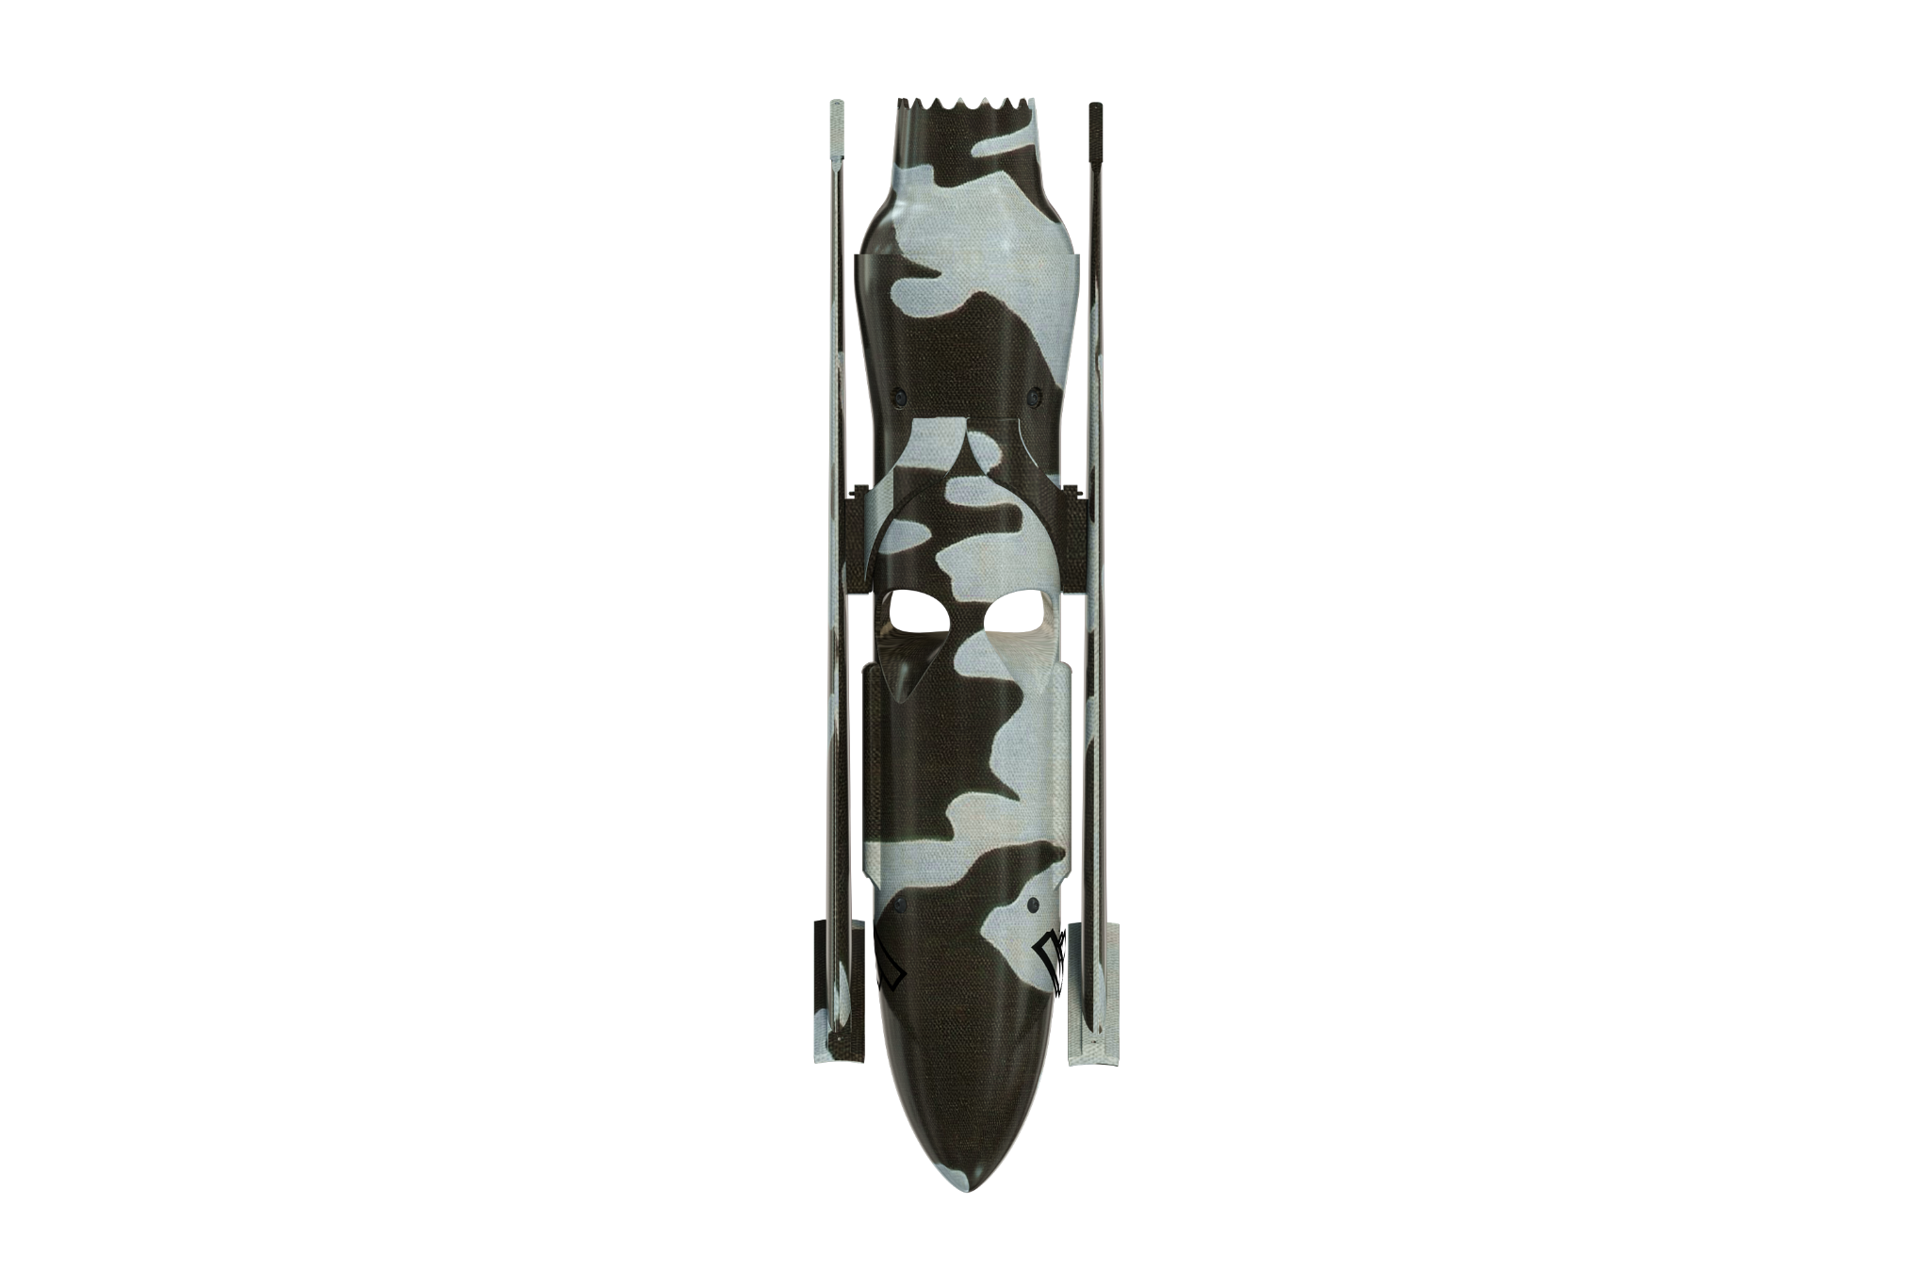
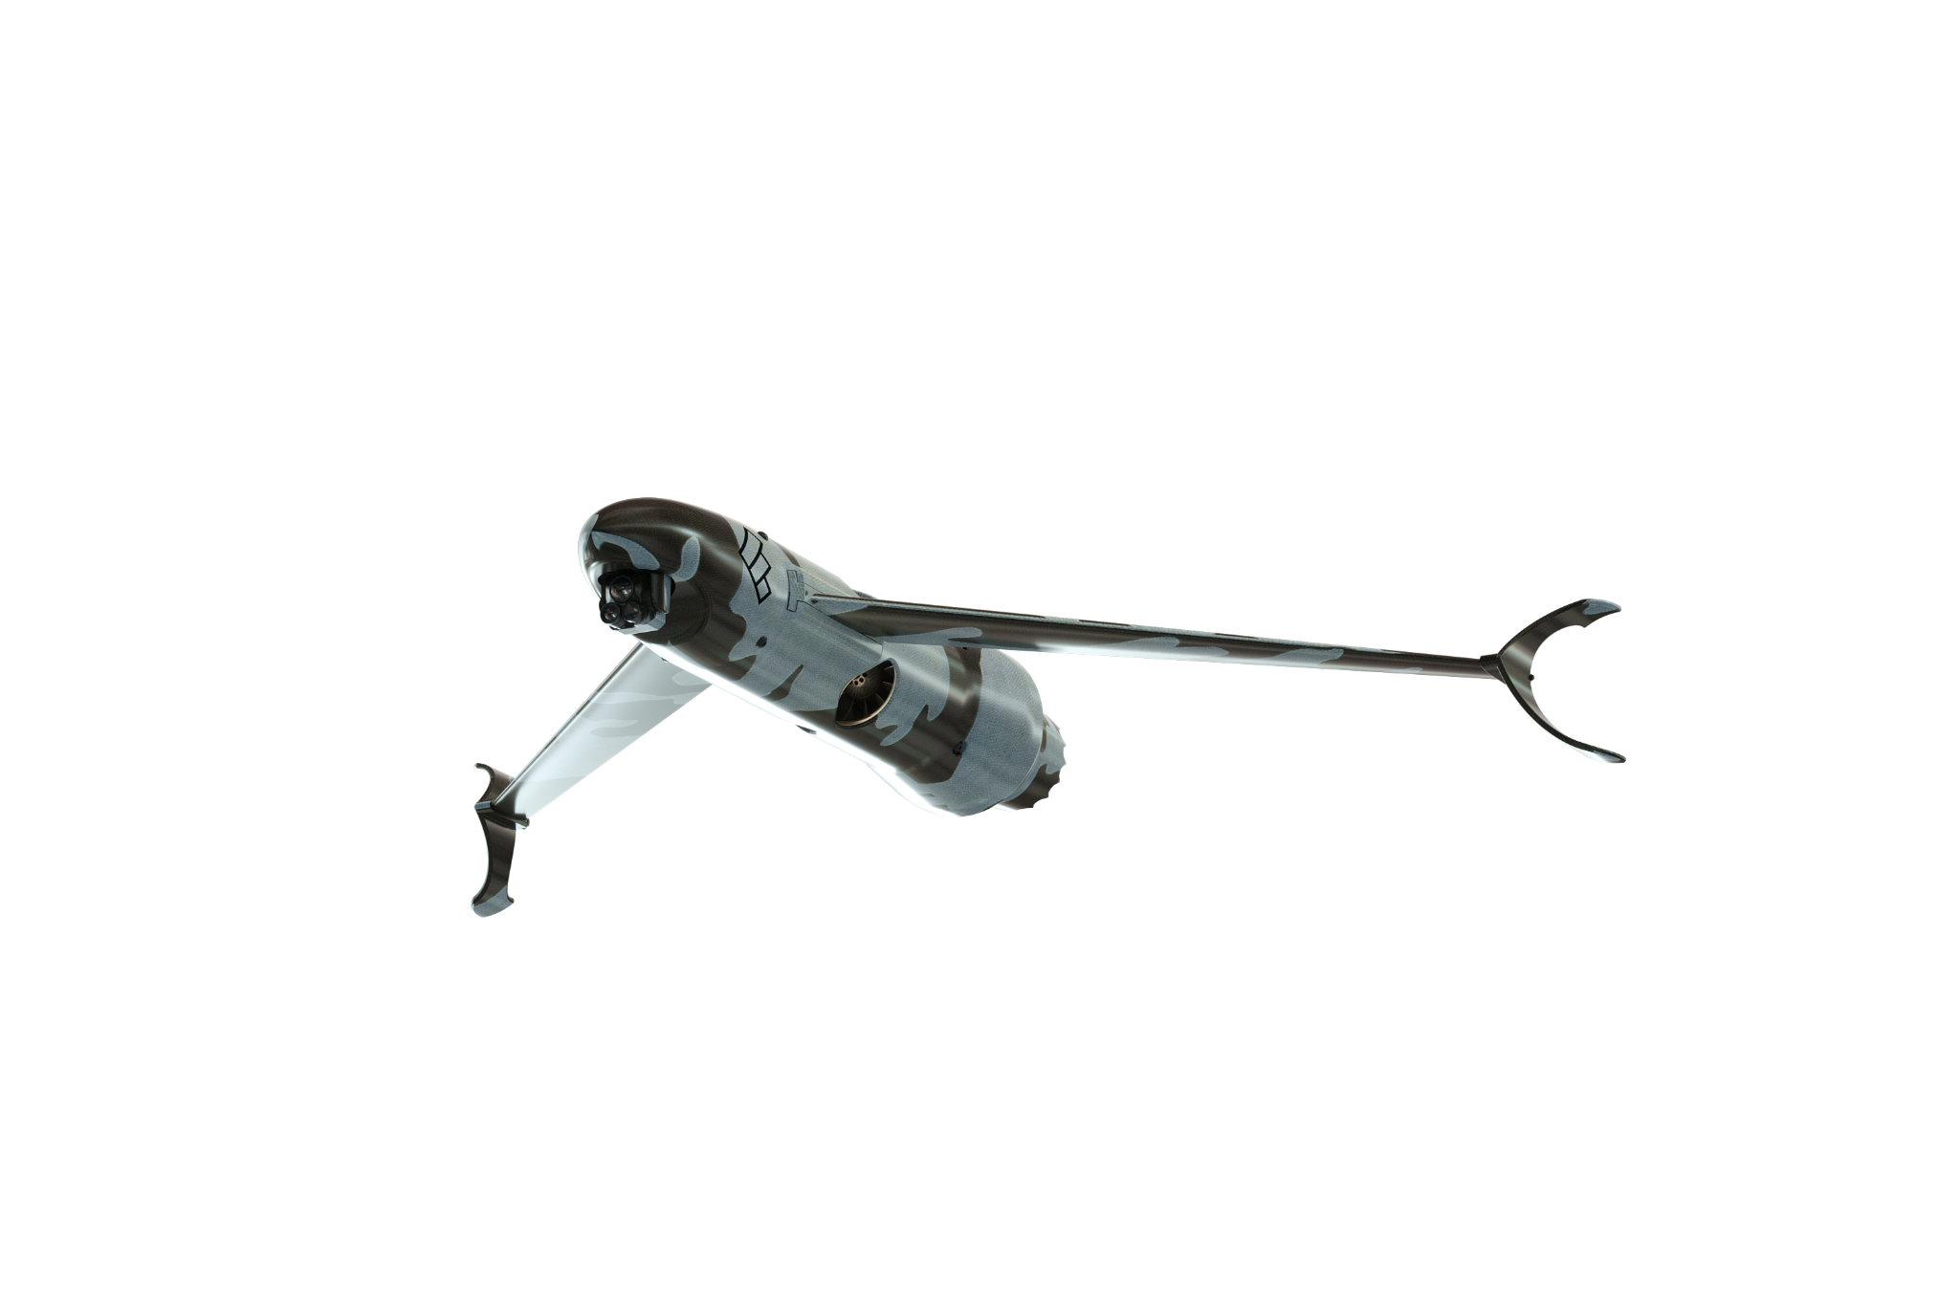
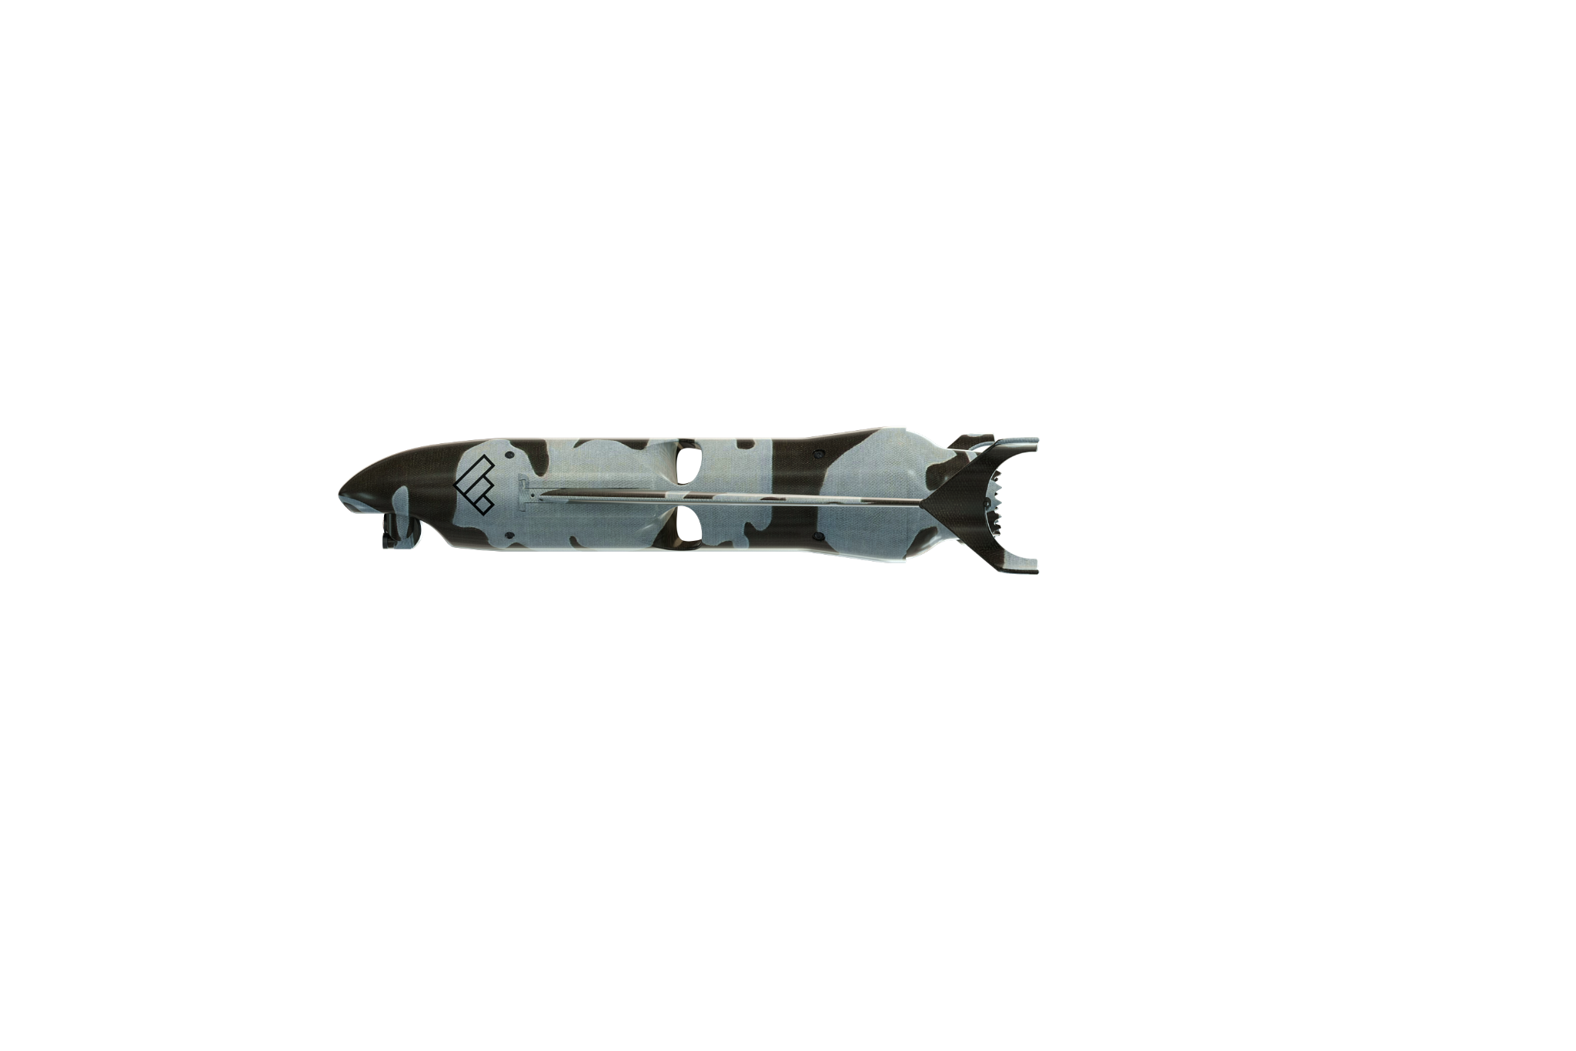
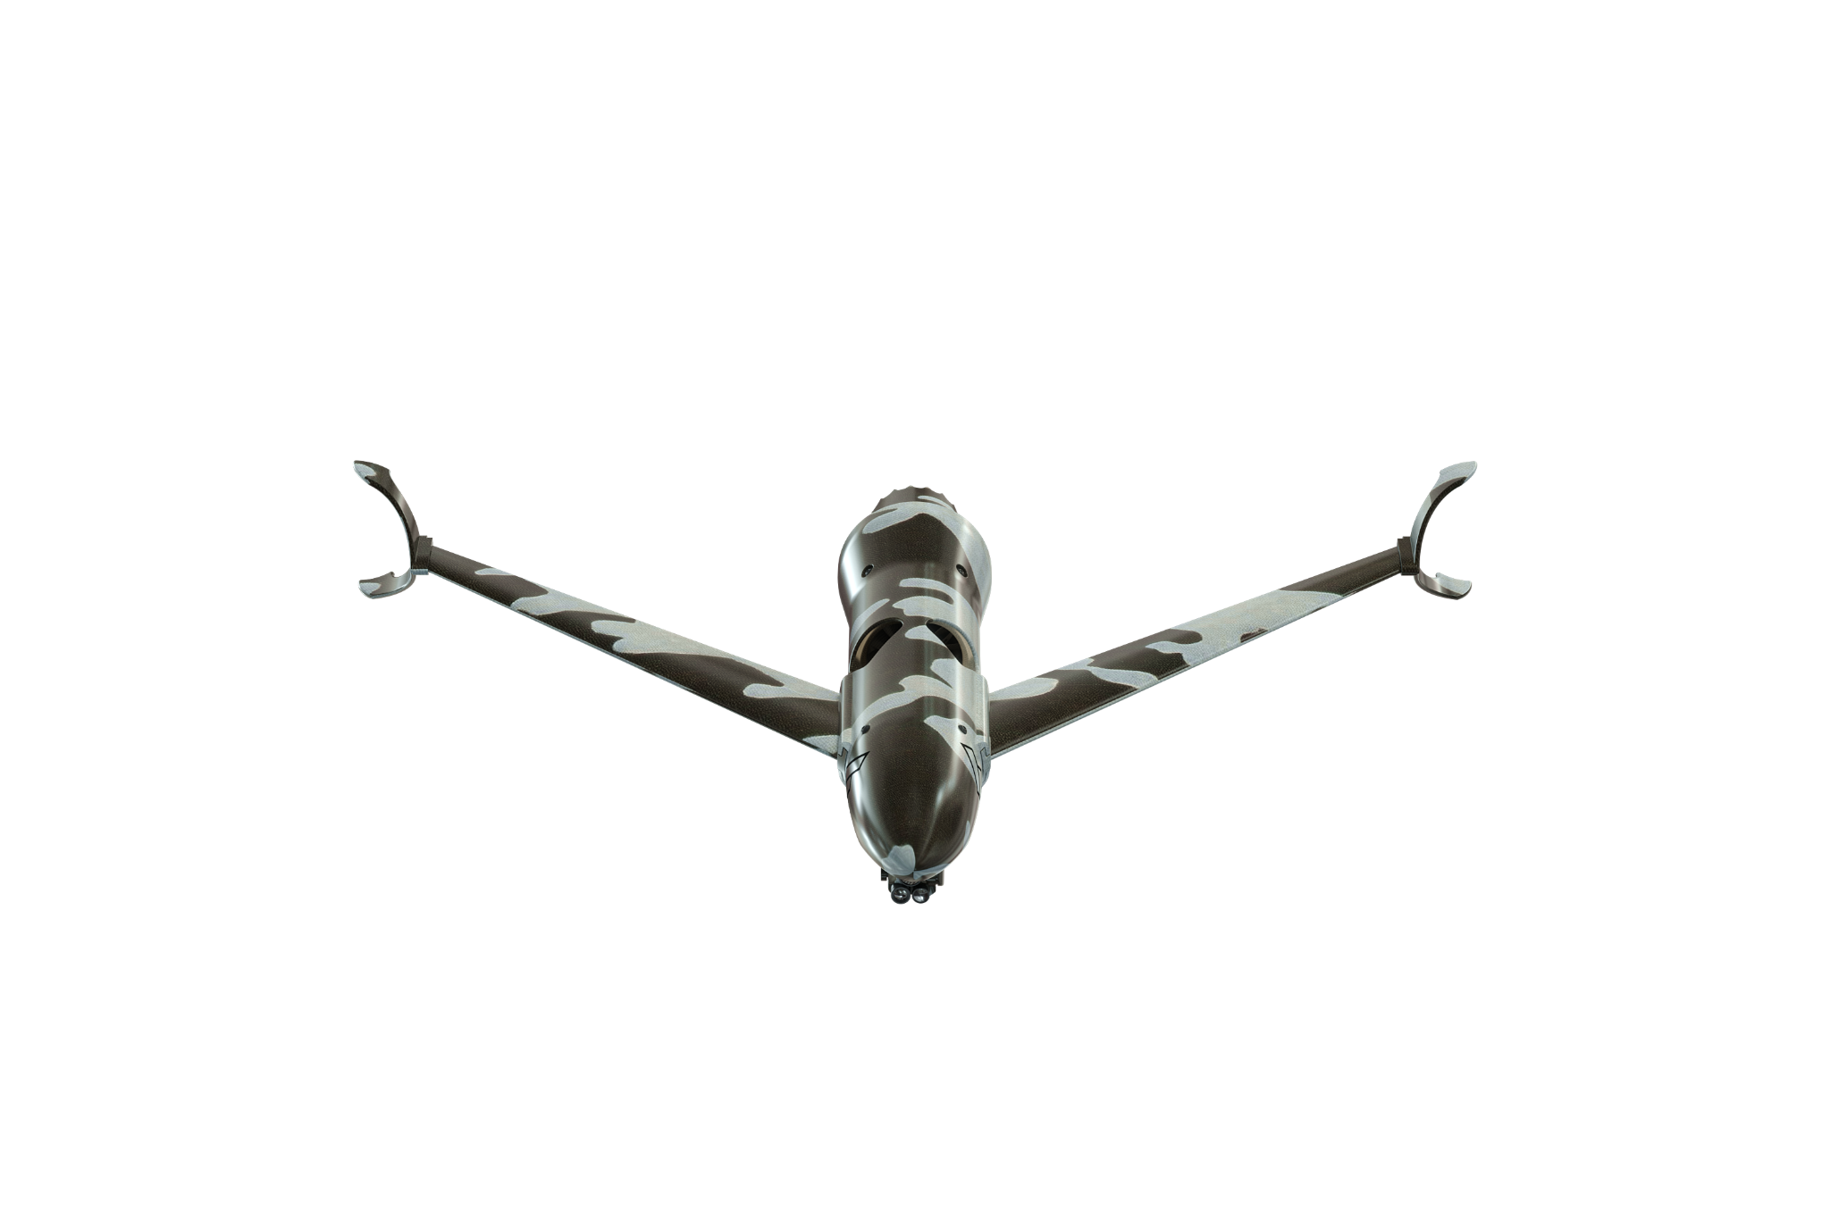
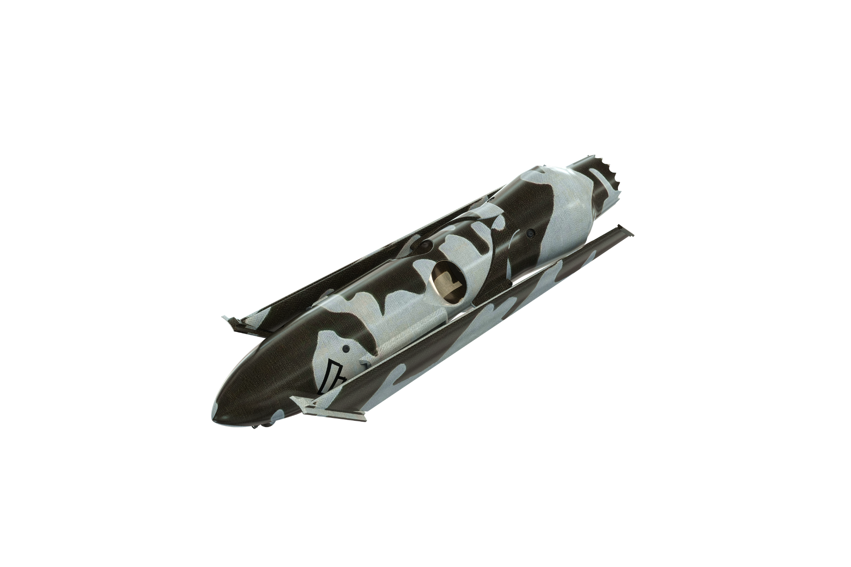
El NIÑO 10
Miniature Precision Guided Systems MPGS
SUAS FOR ALL
Every warfighter will acquire and precisely attack targets within and beyond small arms fire ranges with smart weapons
Costs under $10k and infinite scaling allows this to be accessible to every maneuver element in DoD
HIGHLY MOBILE / VTOL
<10-lb hand-launched variant designed to stow on the operator and launch at the point of need
Vertical takeoff (hand-thrown) less infrastructure = less weight
TAK-Controlled/ Hands-Free Engagement
El Niño is empowered with onboard processing and sensor arrays to engage targets with minimal input from the operator, all on their TAK device
C-UAS
Countering airborne threats with vision and seeker based aerial engagement
Thrust Vector Controlled Interceptors protect critical infrastructure and assets
Hyper-Maneuverable
EDF propulsor for extreme performance & range extended beyond quadrotor and dash speeds outrun any target
2+ lbs of payload tradespace allows for a healthy amount of stopping power

Slide 9
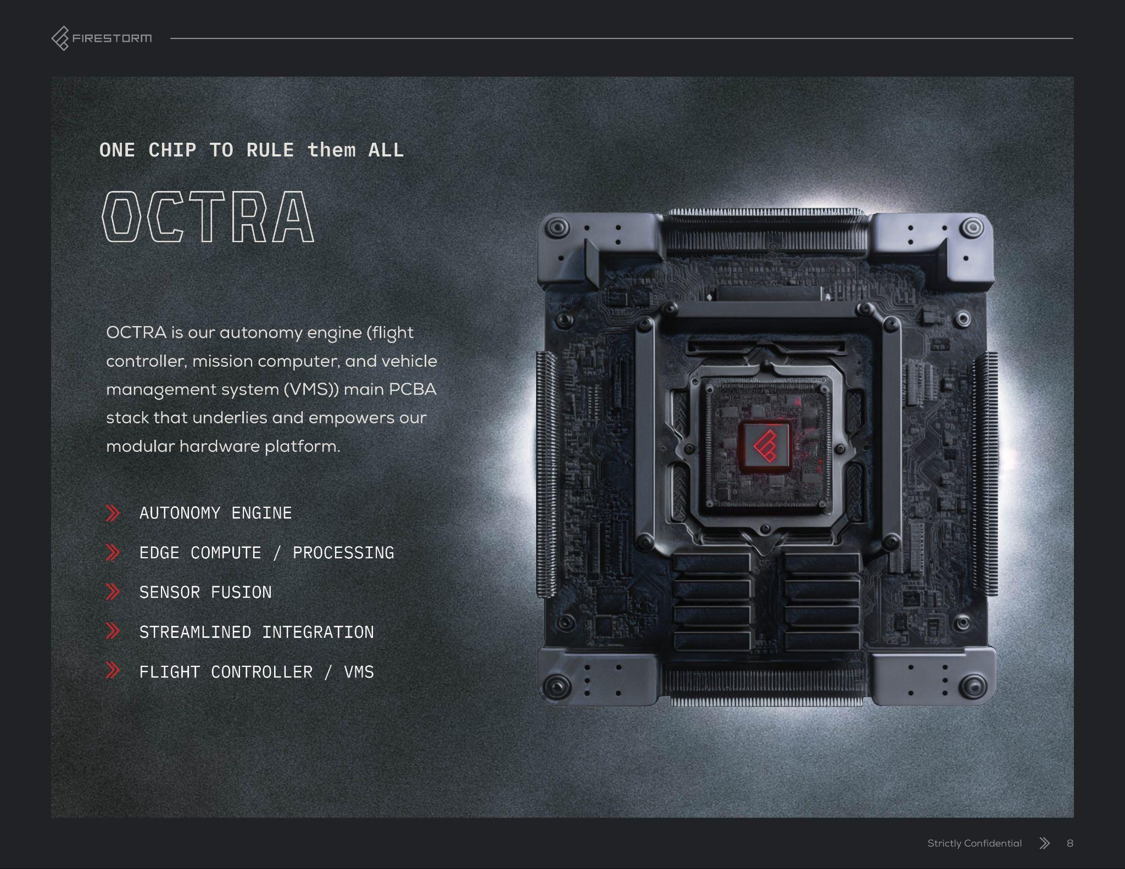

Slide 10
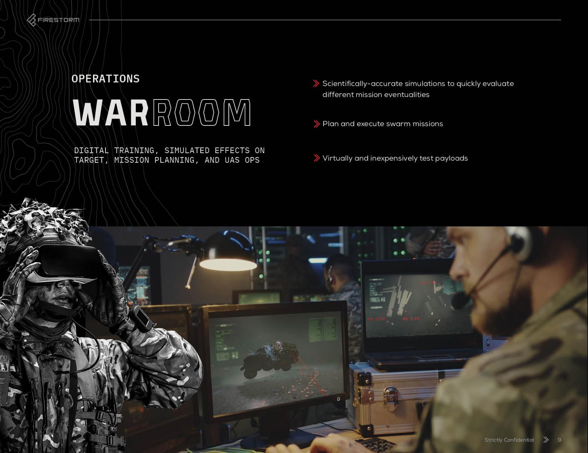

Slide 11
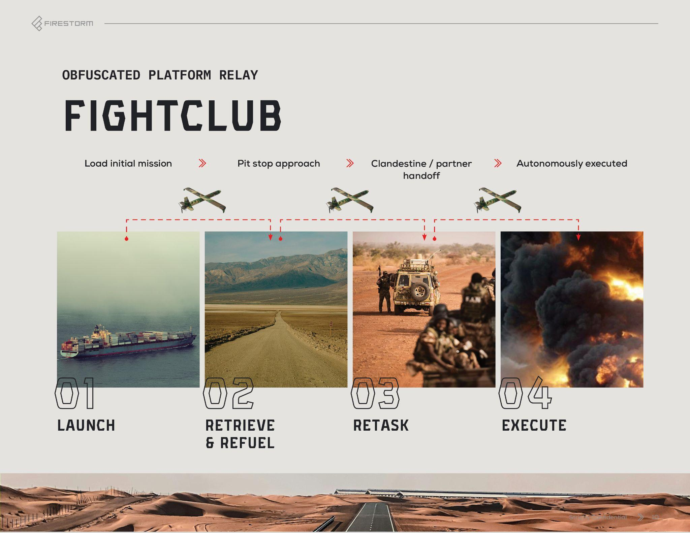

Slide 12


Slide 13
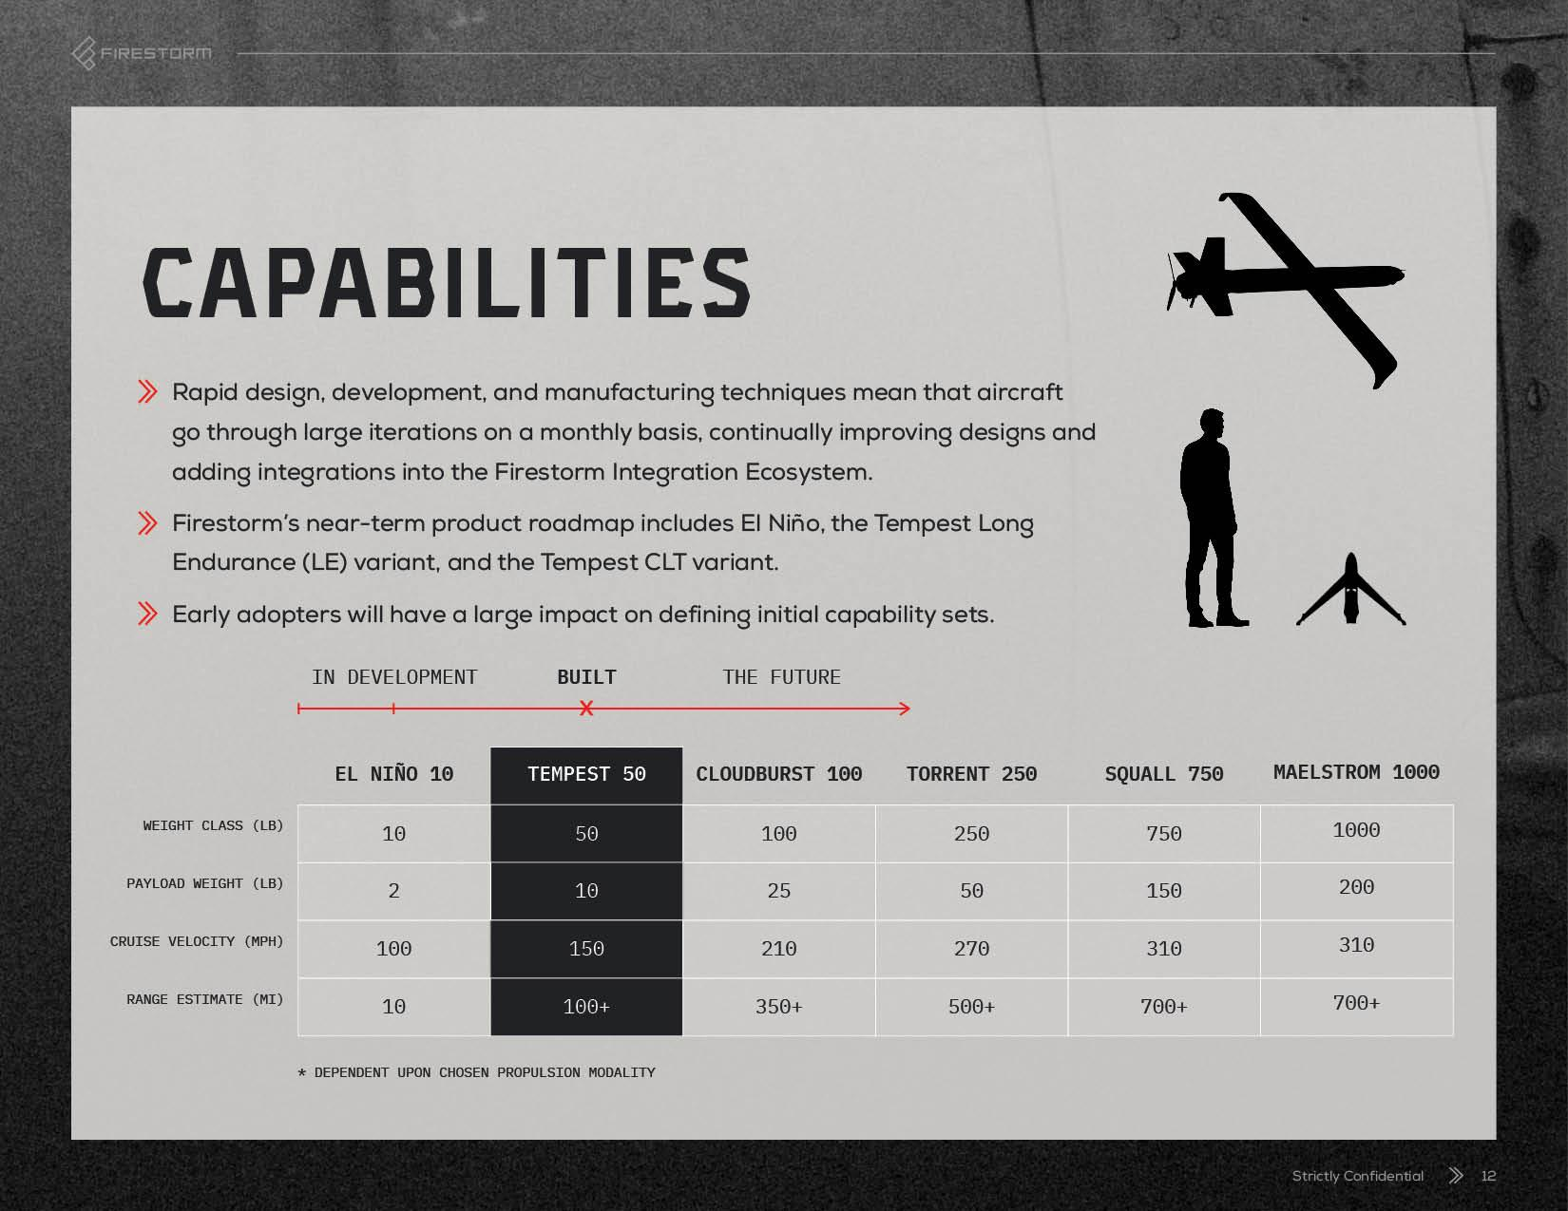

Slide 14


Slide 15


Slide 16


